Slide 1
Algorithms

Slide 2
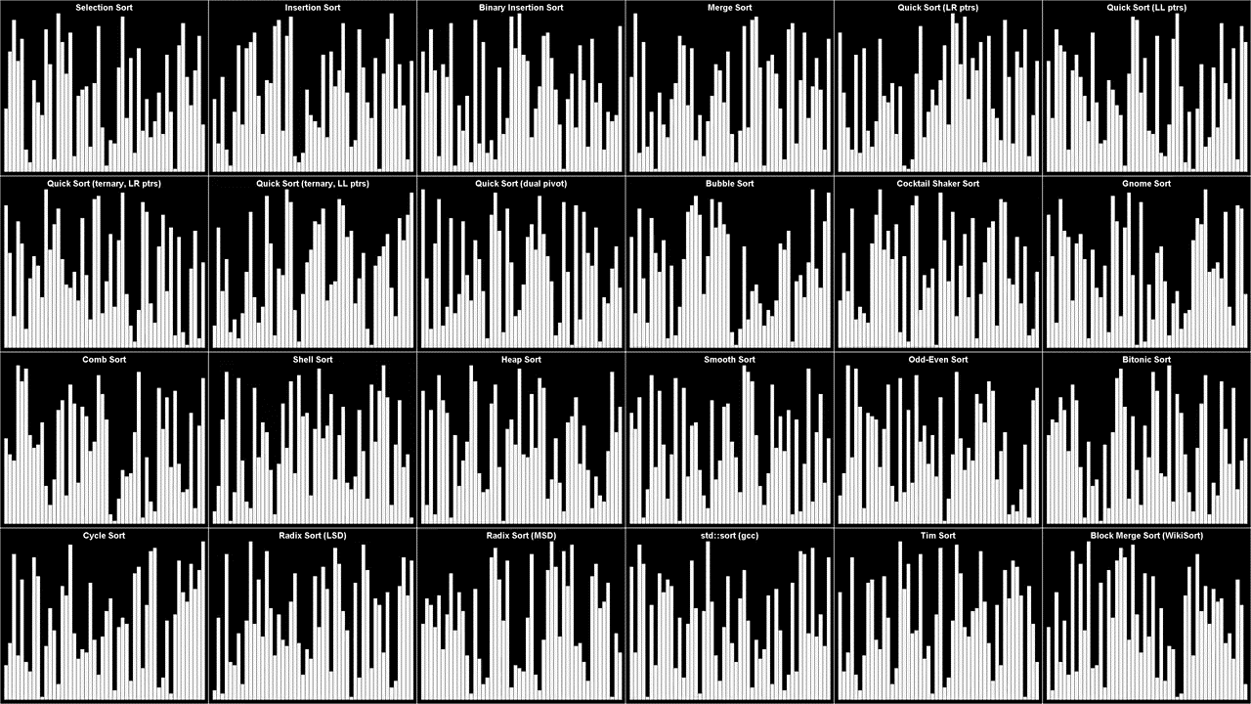
Why Learn Algorithms? (Sorting Problem)

Slide 3
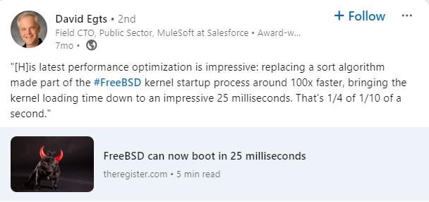
Why Learn Algorithms? (Sorting Problem)

Slide 4
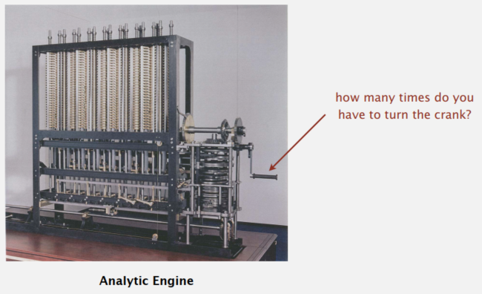
Running Time
How long will my program take? The running time should increase with problem size, but the question of by how much it increases naturally comes up every time we develop and run a program.

Slide 5
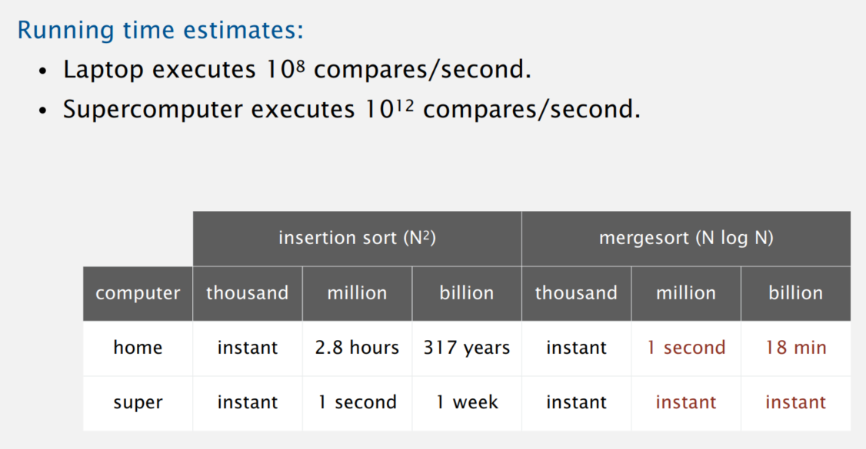
Running Time

Slide 6
Running Time and Big O Notation
Basic Examples:
Power Calculation
Selection Sort
Binary Search
Two Sums

Slide 7
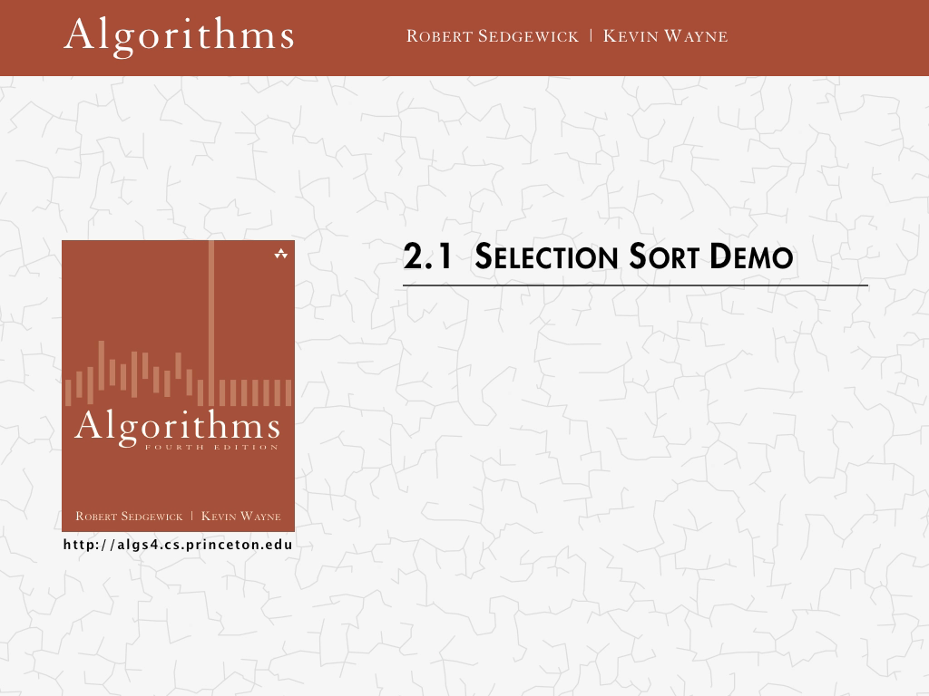
Selection Sort

Slide 8
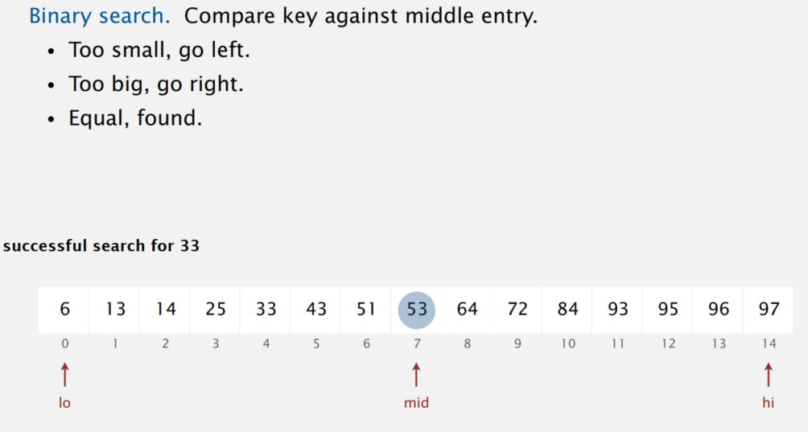
Binary Search

Slide 9
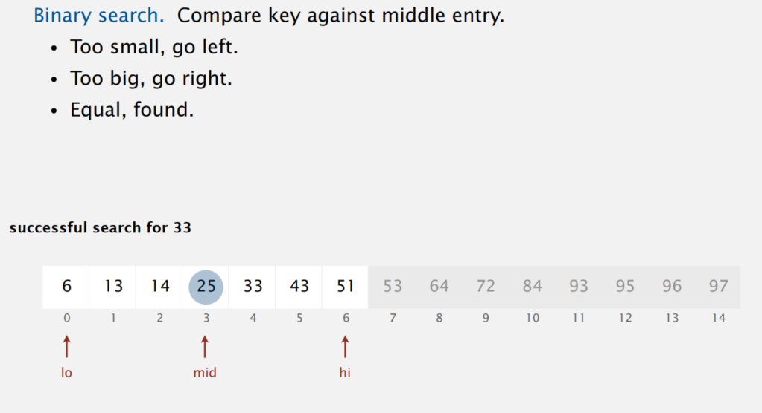
Binary Search

Slide 10
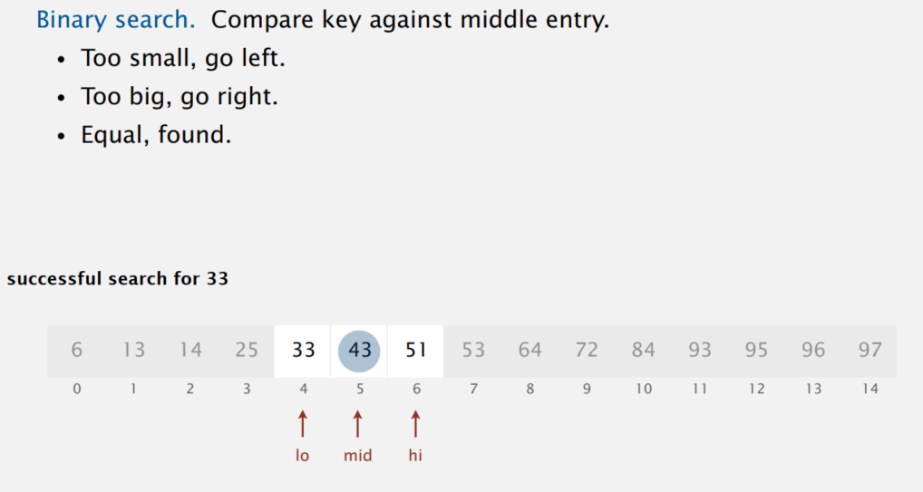
Binary Search

Slide 11
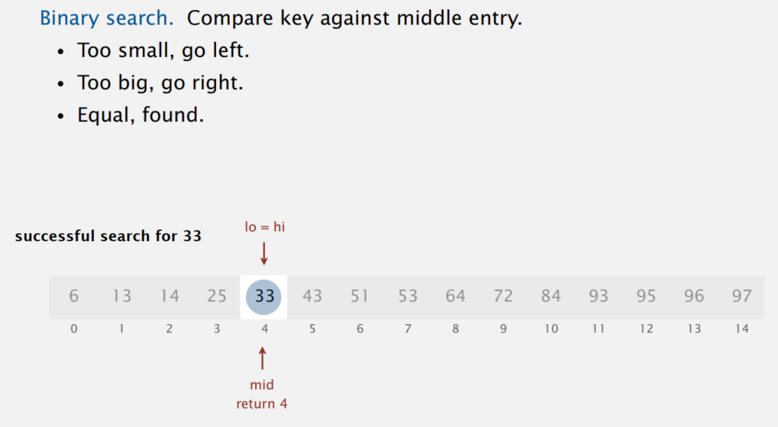
Binary Search

Slide 12
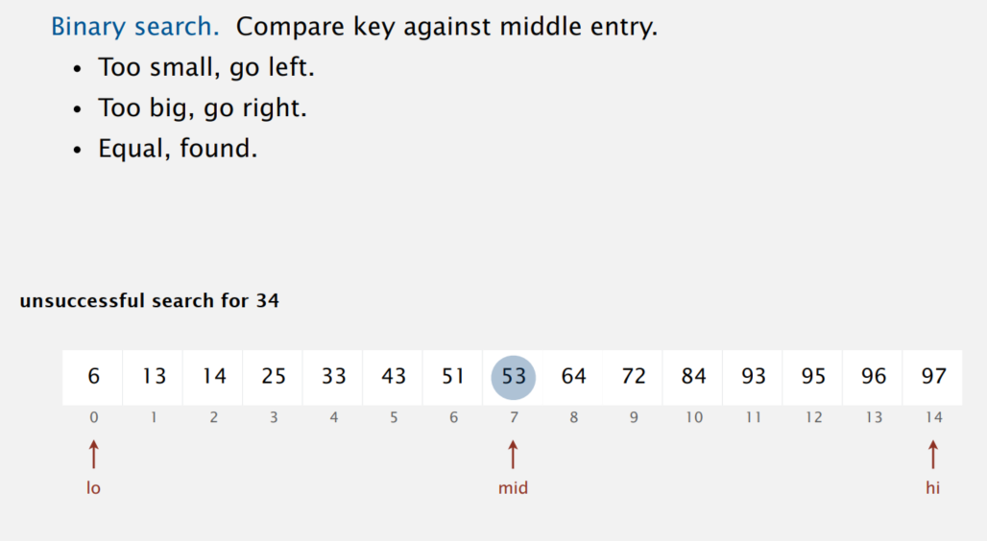
Binary Search

Slide 13
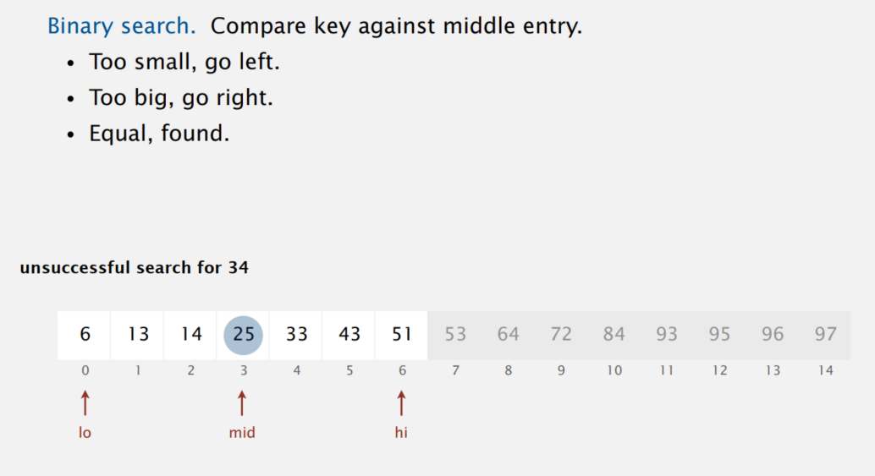
Binary Search

Slide 14
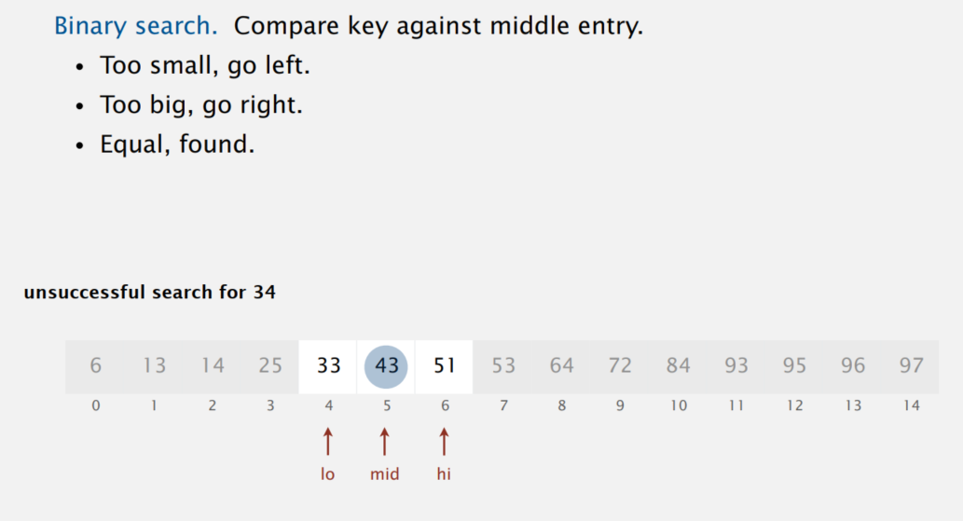
Binary Search

Slide 15
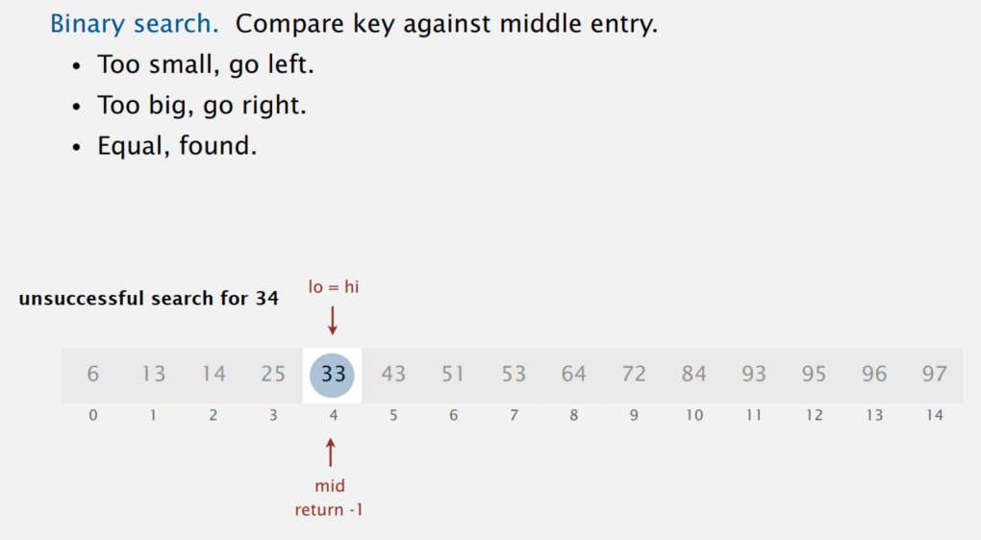
Binary Search

Slide 16
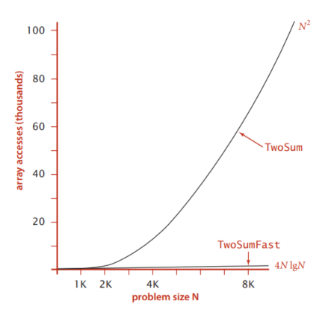
Two Sums Problem

Slide 17
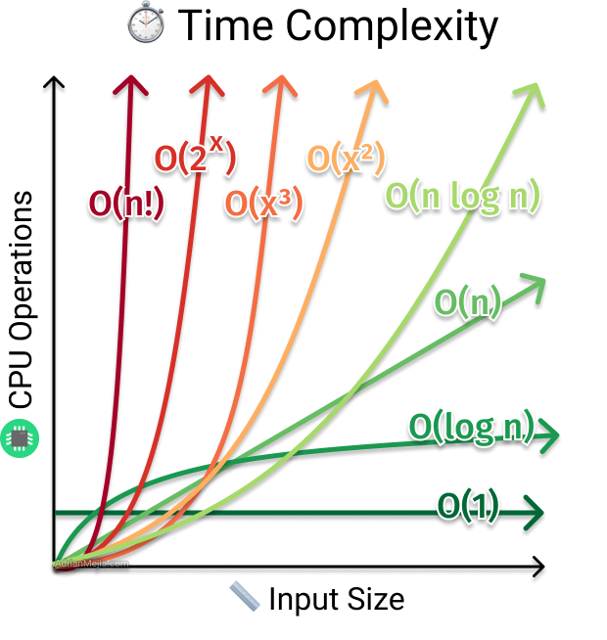
Algorithms Complexity

Slide 18
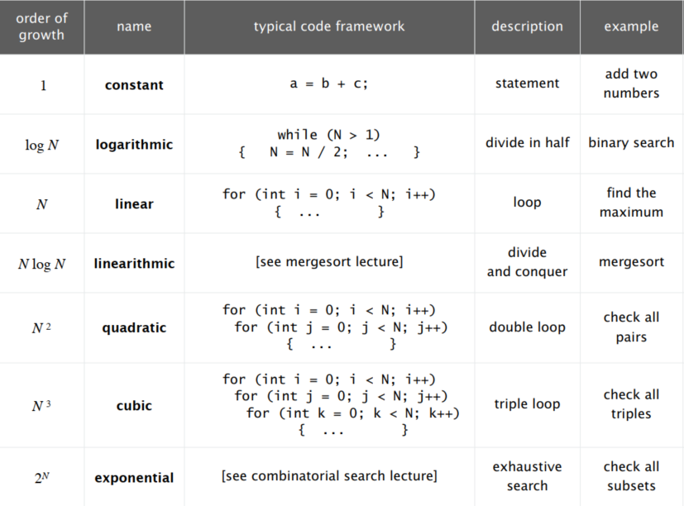
Common order-of-growth Classifications

Slide 19
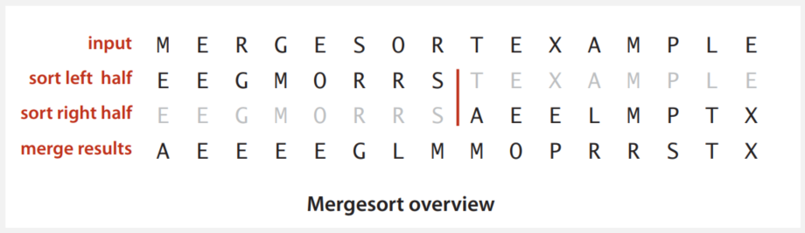
Merge Sort
Basic plan:
・ Divide array into two halves. ・ Recursively sort each half. ・ Merge two halves.

Slide 20

Merging Demo

Slide 21
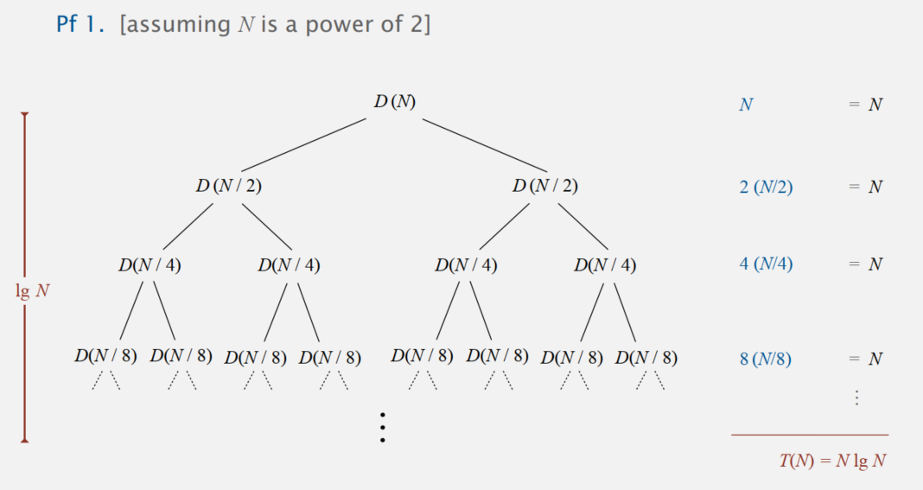
Divide-and-Conquer Recurrence

Slide 22
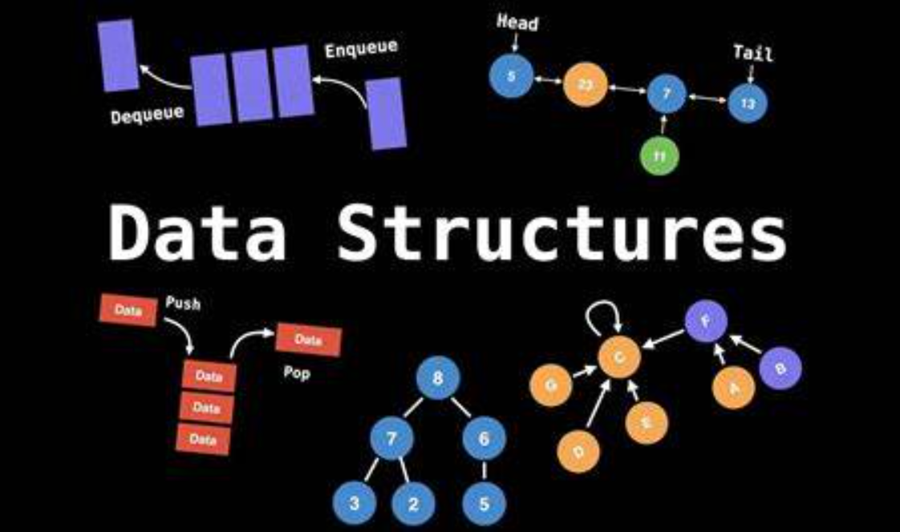

Slide 23
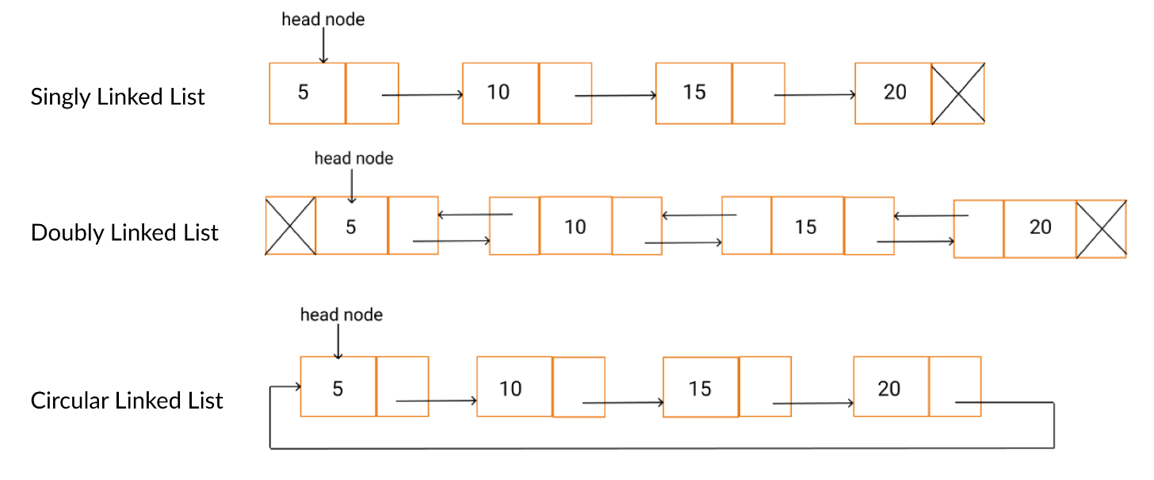
Linked Lists

Slide 24
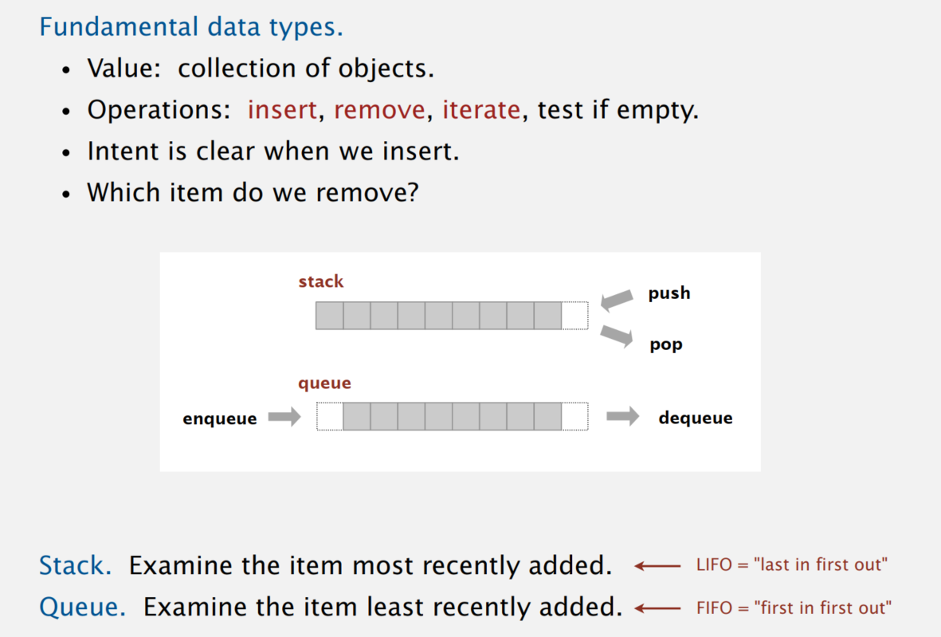
Stacks and Queues

Slide 25
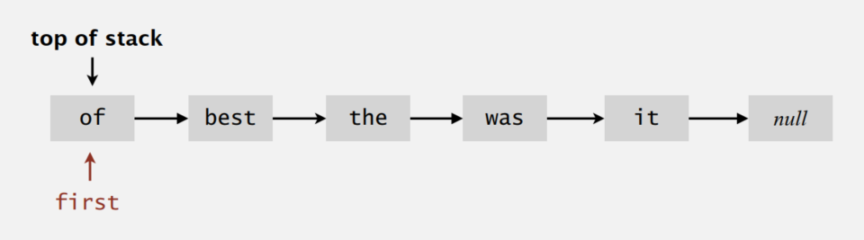
Stack: Linked-List Implementation
Maintain pointer first to first node in a singly-linked list.
Push new item before first.
Pop item from first.

Slide 26
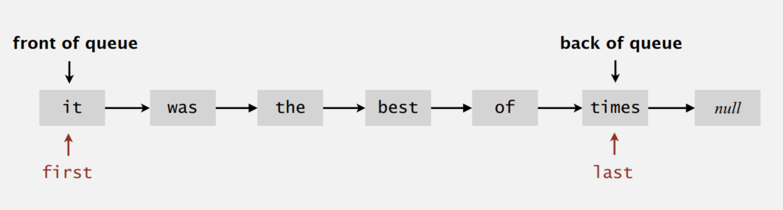
Queue: Linked-List Implementation
Maintain one pointer first to first node in a singly-linked list.
Maintain another pointer last to last node.
Dequeue from first.
Enqueue after last.

Slide 27
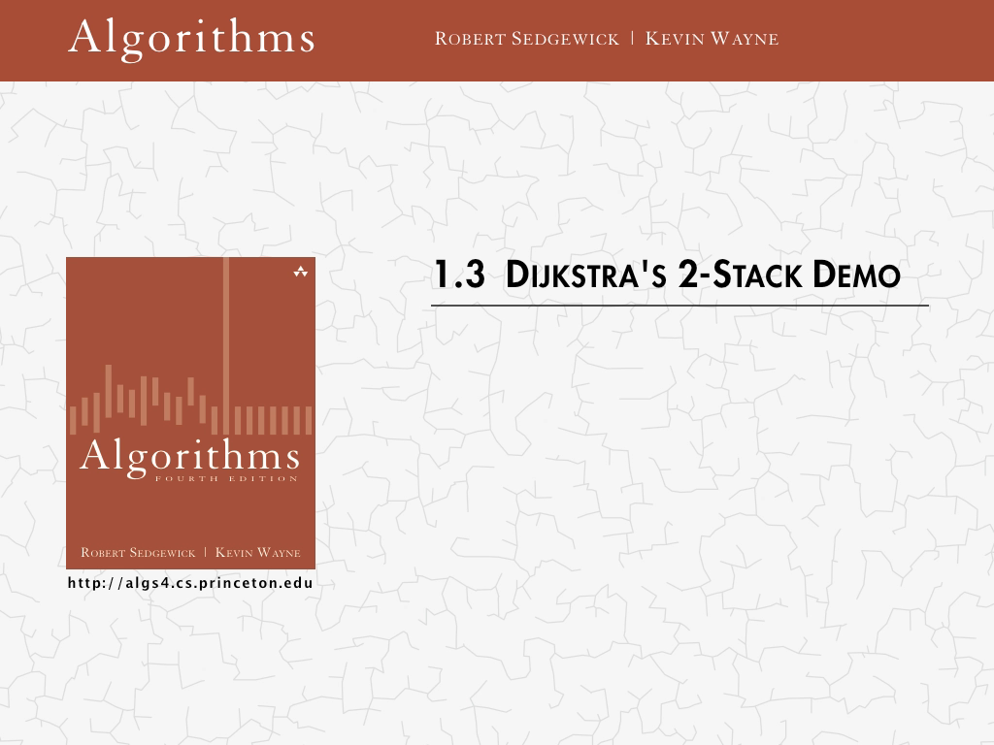
Arithmetic Expression Evaluation

Slide 28


Slide 29
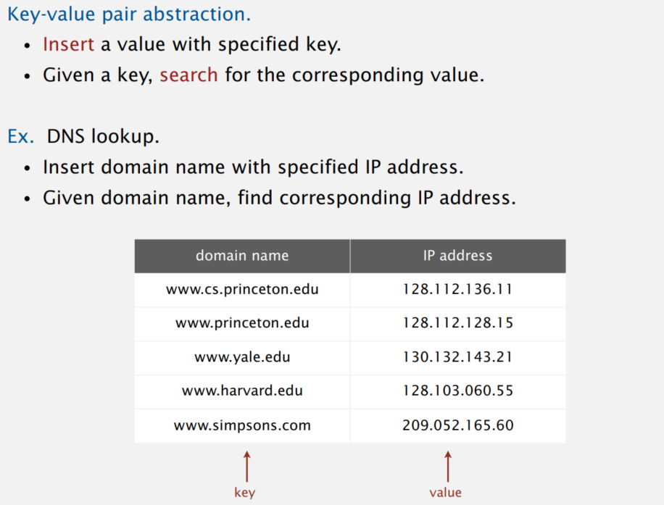
Symbol tables

Slide 30
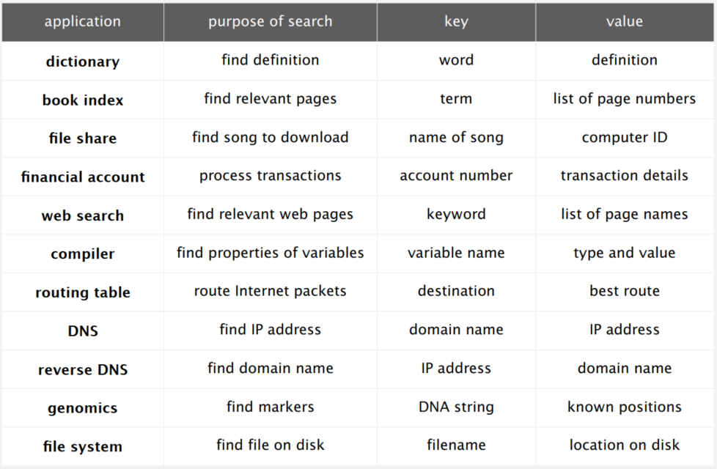
Symbol Table Applications

Slide 31
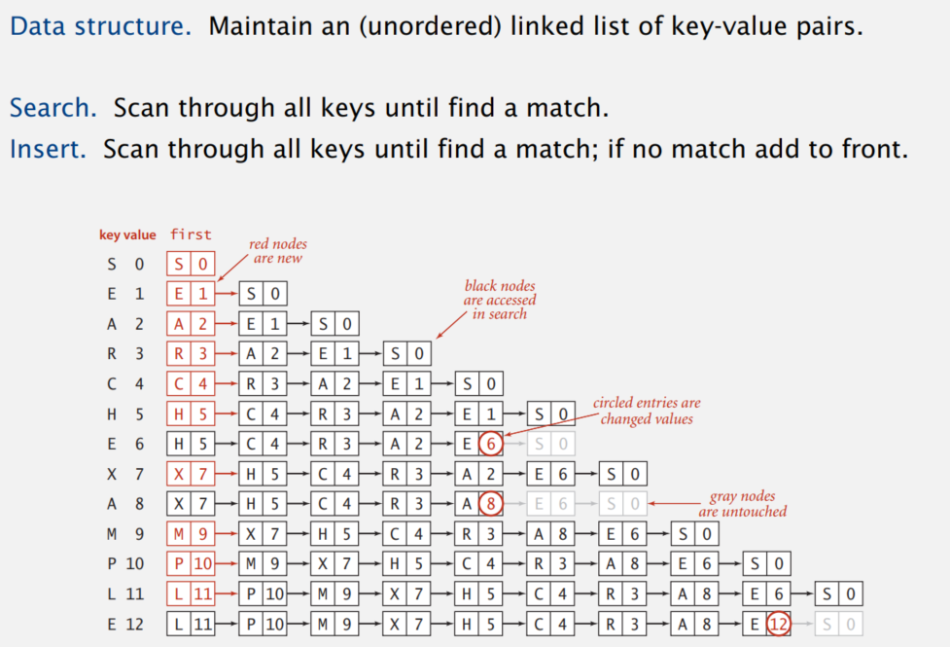
Elementary Implementations

Slide 32
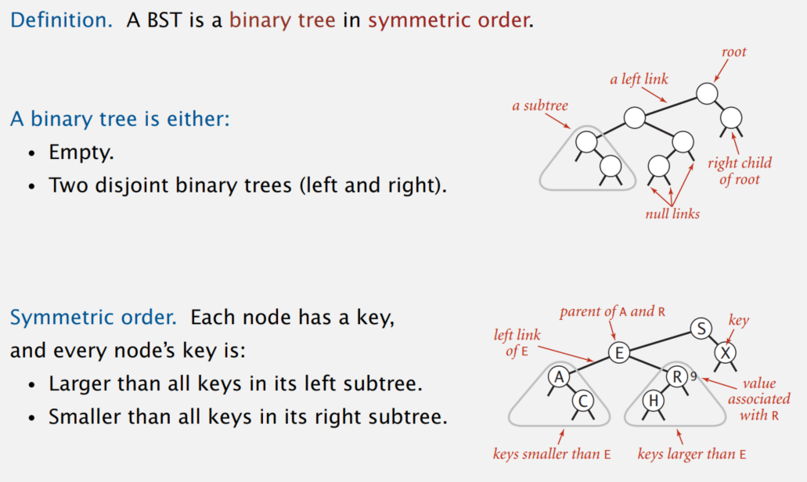
Binary Search Trees

Slide 33
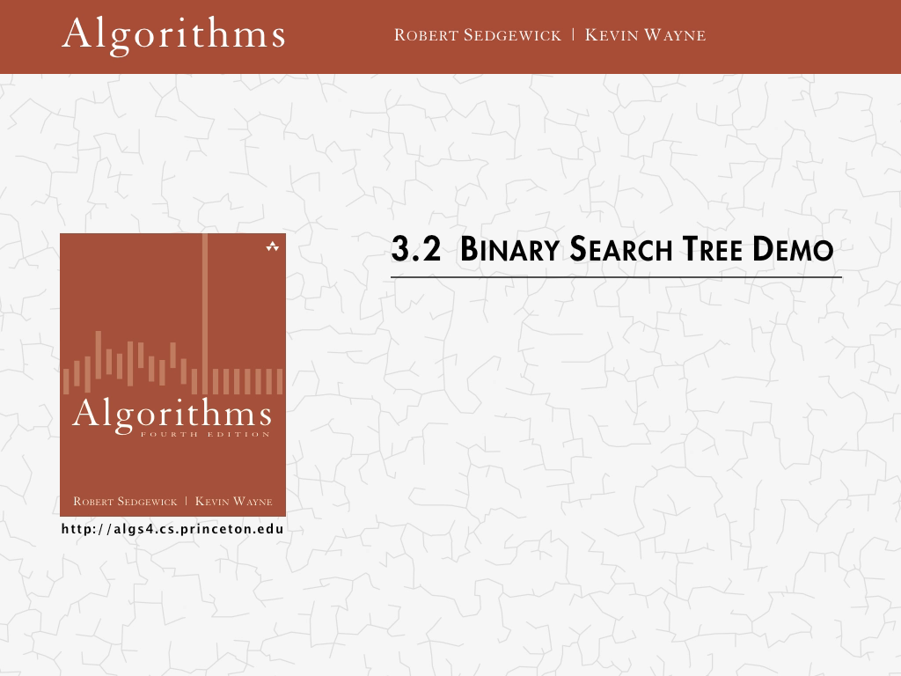
Binary Search Trees

Slide 34
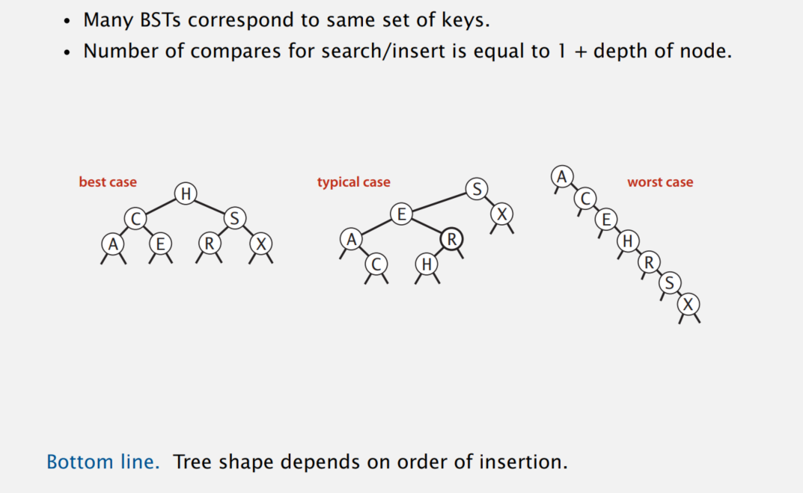
Tree Shape

Slide 35

Red-Black Trees

Slide 36
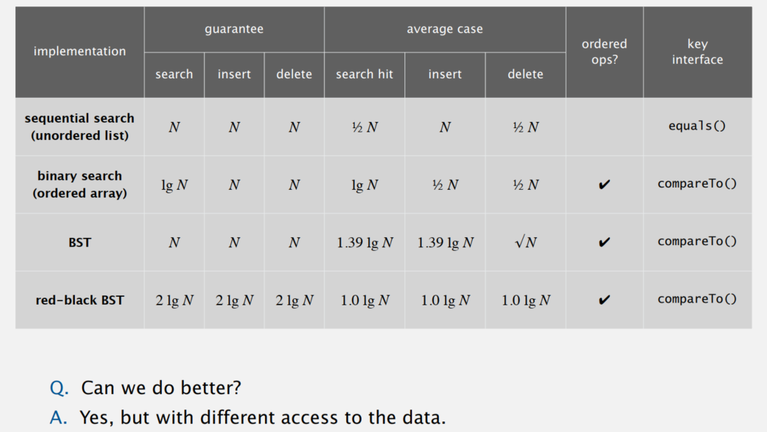
Symbol Table Implementations: Summary

Slide 37
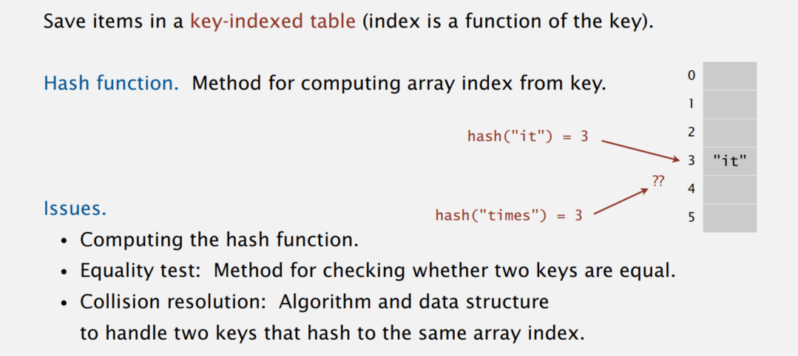
Hashing: Basic Plan

Slide 38
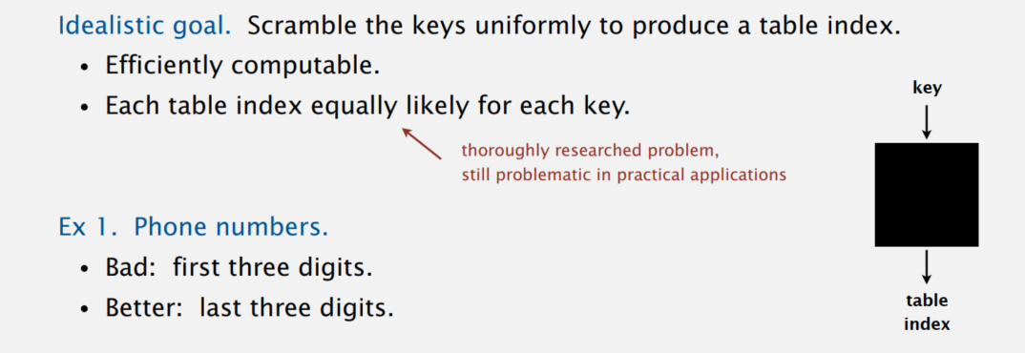
Computing the Hash Function

Slide 39
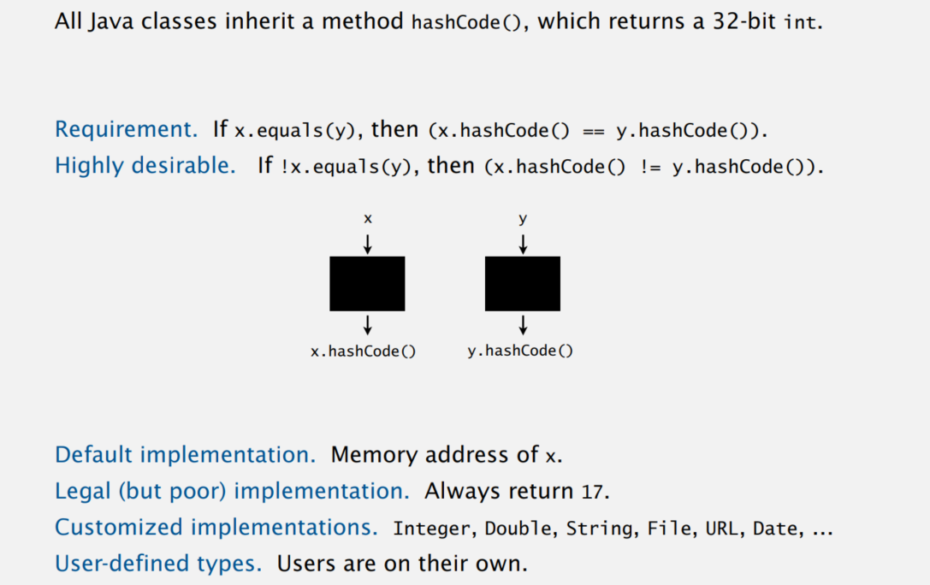
Java’s Hash Code Conventions

Slide 40
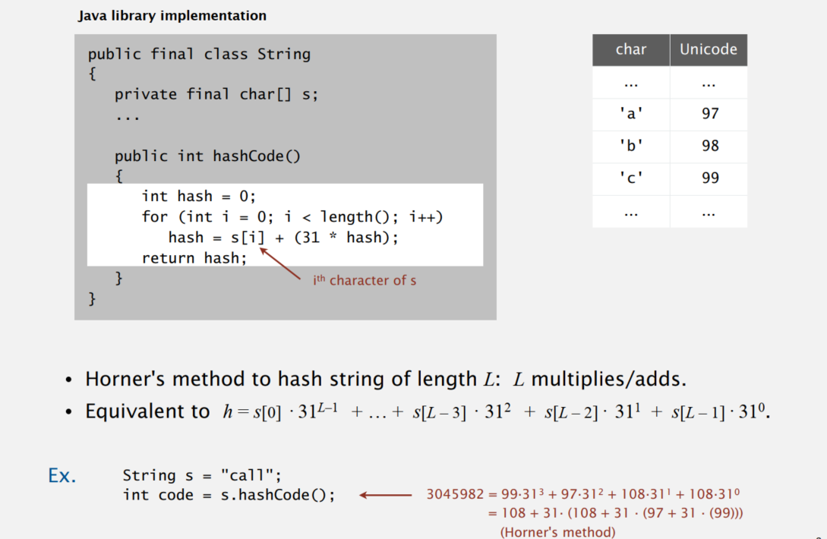
Implementing Hash Code: Strings

Slide 41
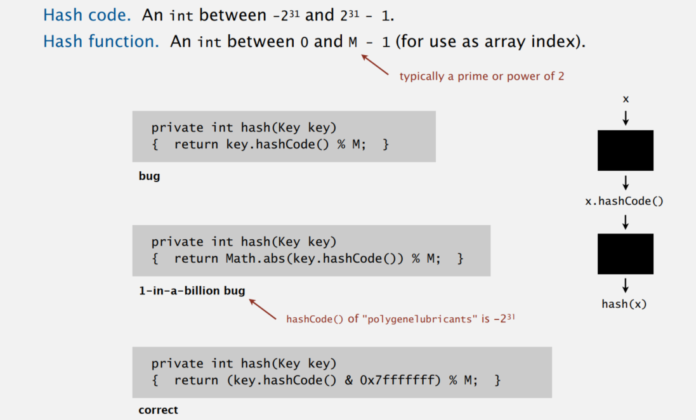
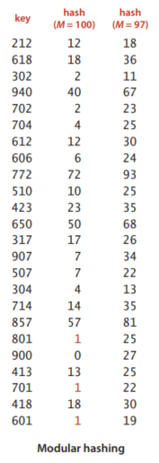
Modular Hashing

Slide 42
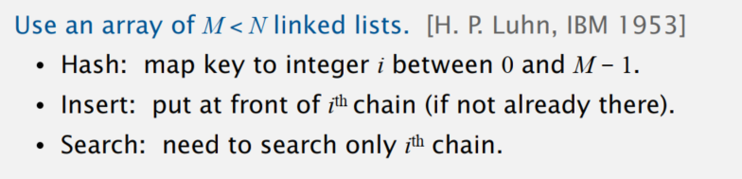
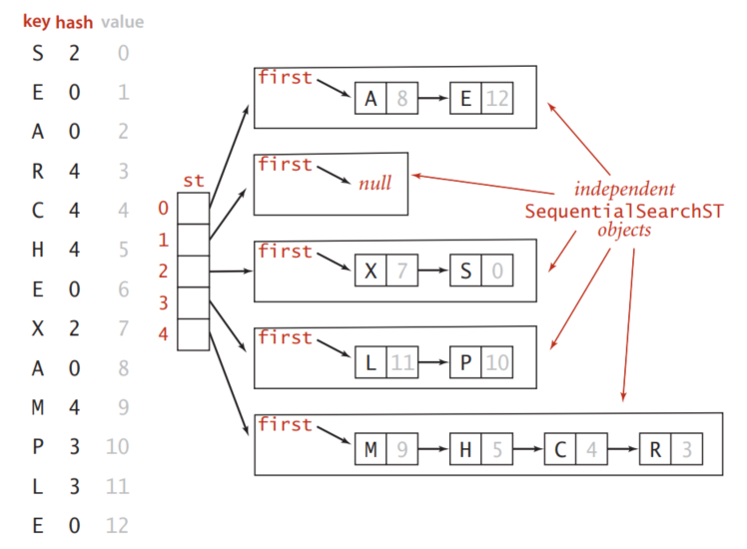
Separate-Chaining Symbol Table

Slide 43

Linear-Probing Hash Table Demo

Slide 44
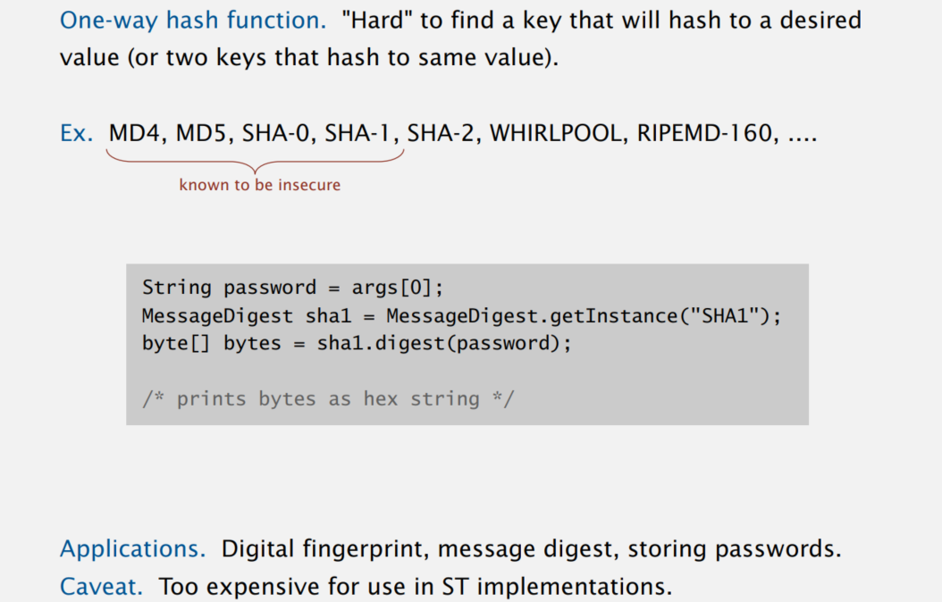
One-Way Hash Functions

Slide 45
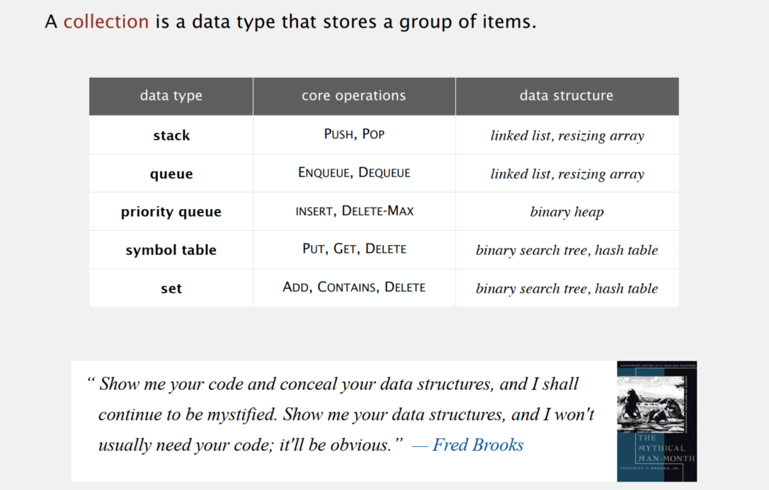
Collections

Slide 46
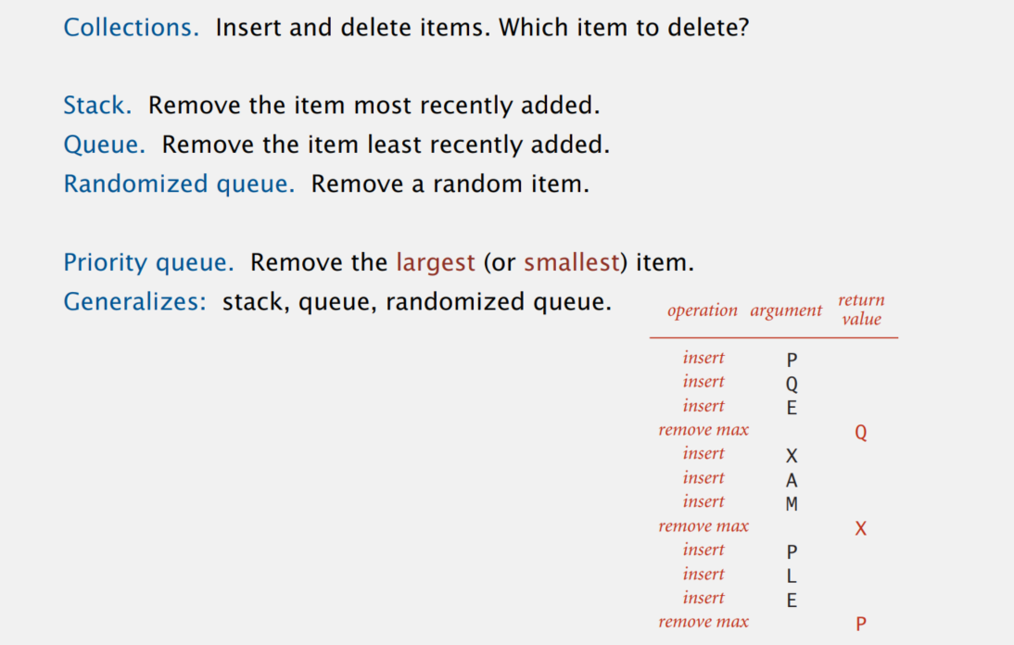
Priority Queue

Slide 47
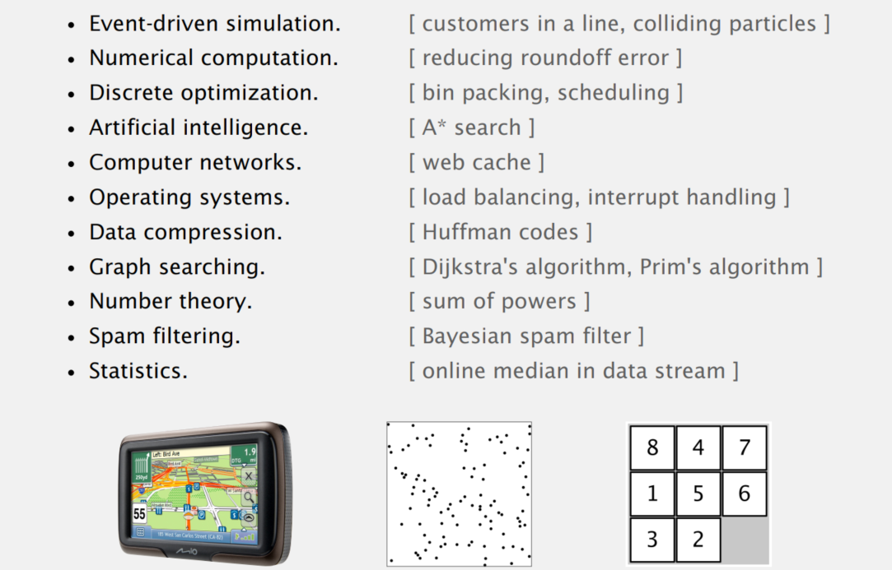
Priority Queue: Applications

Slide 48
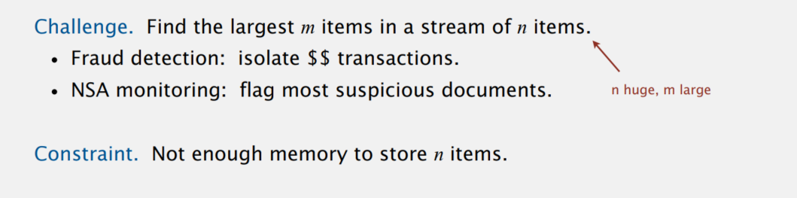
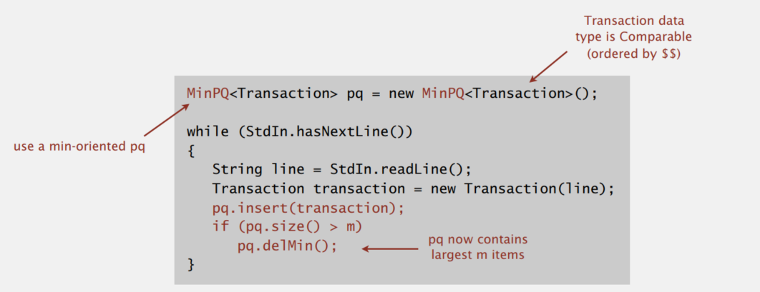
Example

Slide 49
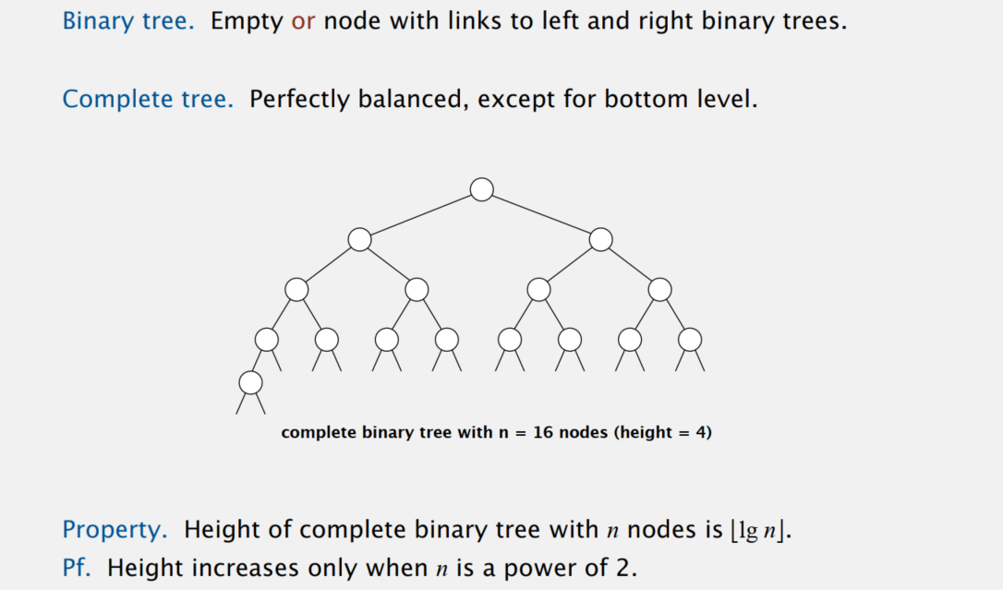
Complete Binary Tree

Slide 50
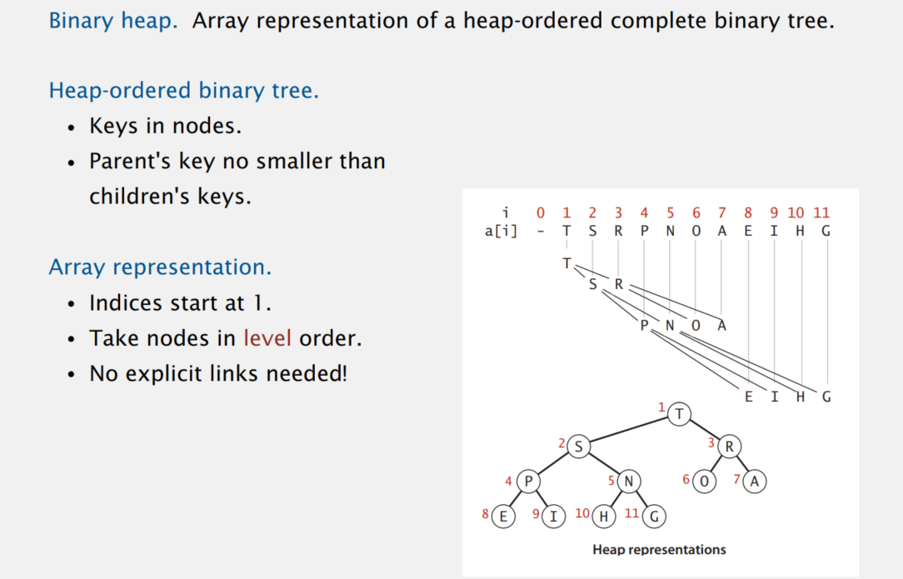
Binary Heap: Representation

Slide 51
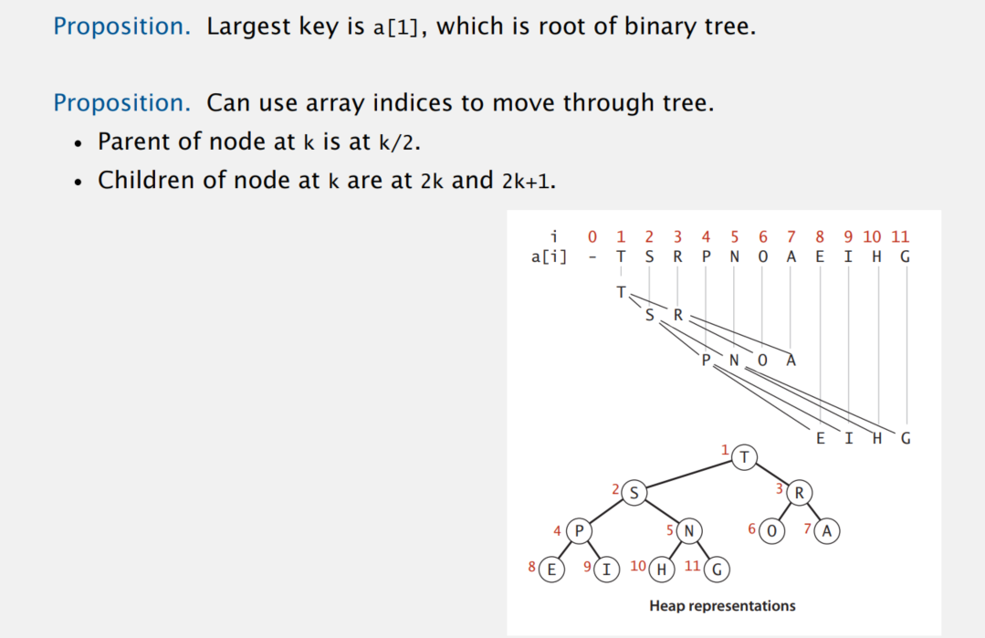
Binary Heap: Properties

Slide 52

Binary Heap Demo

Slide 53
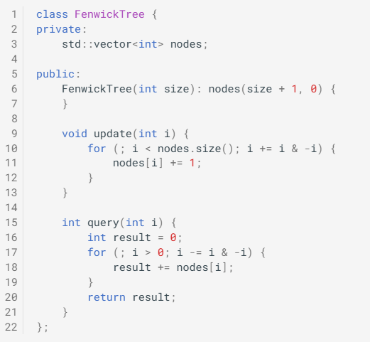
Binary Indexed (Fenwick) Tree
We will use the function LSOne(S) which is ((S) & -(S))) and produces the first Least Significant One-bit in S
The item at index i of Fenwick Tree ft is responsible for items in the range [(i-LSOne(i)+1)…..i] of the frequency array

Slide 54
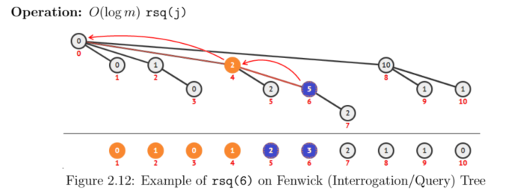
Binary Indexed (Fenwick) Tree

Slide 55

Binary Indexed (Fenwick) Tree

Slide 56

What can we do when subproblems overlap?

Slide 57

Back to Fibonacci

Slide 58


Longest Common Subsequence

Slide 59

Longest Common Subsequence

Slide 60

The Knapsack Problem
Given n objects and a knapsack
Object i has weight w_{i} and value v_{i}
Knapsack has maximum weight W
Goal: fill knapsack to maximize total value

Slide 61
The Knapsack DP: False Start
Def. OPT(i) = max profit subset of items 1 ,…, i
Case 1: OPT does not select item i
OPT selects best of { 1, 2, …, i-1 }
Case 2: OPT selects item i
accepting item i does not immediately imply that we will have to reject other items
without knowing what other items were selected before i, we don't even know if we have enough room for i
Conclusion. Need more sub-problems!

Slide 62

The Knapsack DP: Adding a new Variable
Def. OPT(i, w) = max profit subset of items 1, …, i with weight limit w.
Case 1: OPT does not select item i.
OPT selects best of { 1, 2, …, i-1 } using weight limit w
Case 2: OPT selects item i.
new weight limit = w – w_{i}
OPT selects best of { 1, 2, …, i–1 } using this new weight limit

Slide 63

The Knapsack DP: Example

Slide 64


All-pairs Shortest Paths: Floyd Warshall
Def. The Floyd Warshall Algorithm is an all pairs shortest path algorithm unlike Dijkstra and Bellman Ford which are single source shortest path algorithms. This algorithm works for both the directed and undirected weighted graphs. But it does not work for the graphs with negative cycles (where the sum of the edges in a cycle is negative). It follows Dynamic Programming approach to check every possible path going via every possible node in order to calculate shortest distance between every pair of nodes.
Idea: The shortest path $\text{u} → \text{w}\text{1 }→\text{ · · · }→ \text{wl} → \text{v}$between u and v uses some number of intermediate nodes—possibly none. For the vertices in V as {1, 2, …, n} and let dist(i, j, k) denote the length of the shortest path from i to j in which only nodes {1, 2, …, k} can be used as intermediates. Initially, dist(i, j, 0) is the length of the direct edge between i and j, if it exists, and is ∞ otherwise.

Slide 65

Graphs

Slide 66

Graph Terminology

Slide 67

Depth First Search (DFS)

Slide 68

DFS Usage: Topological Sort

Slide 69

DFS Usage: Topological Sort

Slide 70

Breadth-First Search (BFS)

Slide 71

Shortest Path in Undirected Graphs

Slide 72

Connected Components

Slide 73

Spanning Tree

Slide 74

Minimum Spanning Tree

Slide 75

Prim’s Algorithm

Slide 76

Prim’s Algorithm

Slide 77

Prim’s Algorithm

Slide 78

Prim’s Algorithm

Slide 79

Prim’s Algorithm

Slide 80

Prim’s Algorithm

Slide 81

Prim’s Algorithm

Slide 82

Prim’s Algorithm

Slide 83

Prim’s Algorithm

Slide 84

Prim’s Algorithm

Slide 85

Prim’s Algorithm

Slide 86

Prim’s Algorithm

Slide 87

Prim’s Algorithm

Slide 88

Prim’s Algorithm

Slide 89

Prim’s Algorithm

Slide 90

Prim’s Algorithm

Slide 91

Single Source Shortest Paths

Slide 92


